Slide 1


Students of Tudor Vladimirescu portal
Made by : Busy bees
(Mertic Lucia-Maria, Mateeșescu Niki, Bursuc Ștefana, Lungu Ștefania, Blanaru Ioana)
2022

Slide 2

Project scope
Open a portal to your campus through your device!
Implement an online portal for our campus, so people can stay up to date with campus informations like news, events, etc.

Slide 3
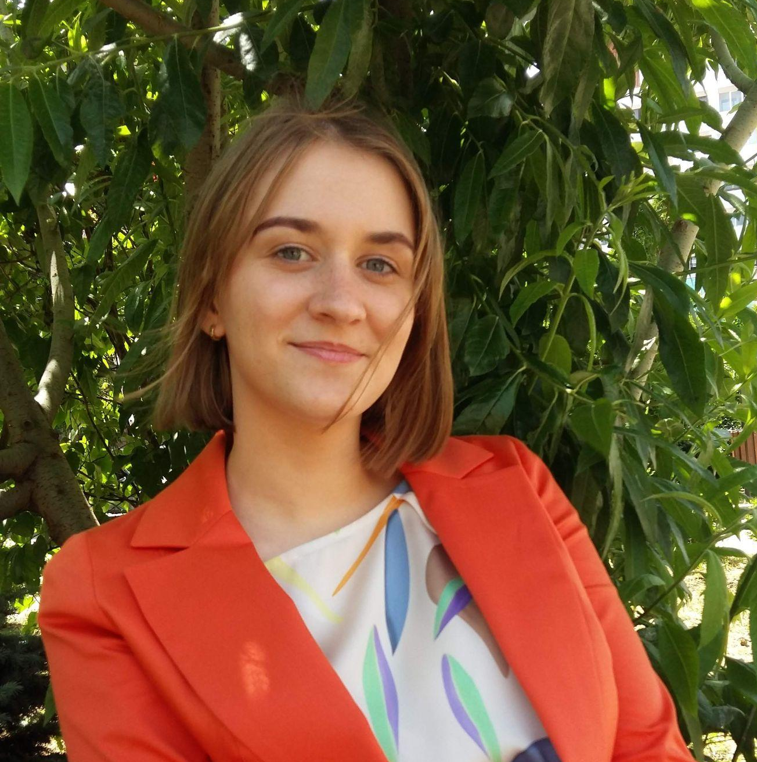

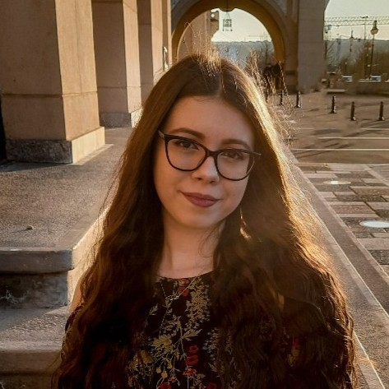
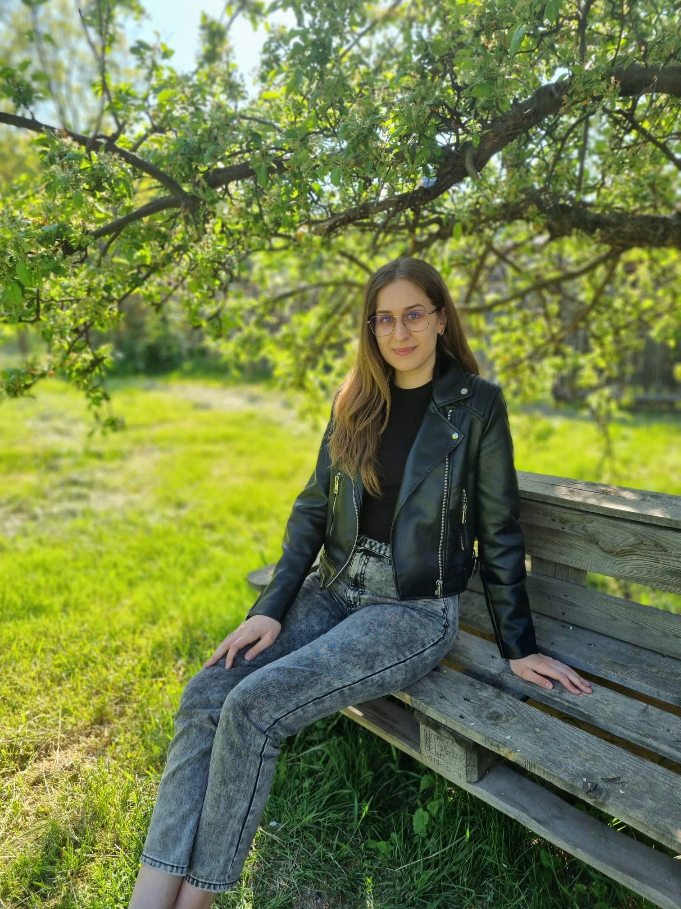
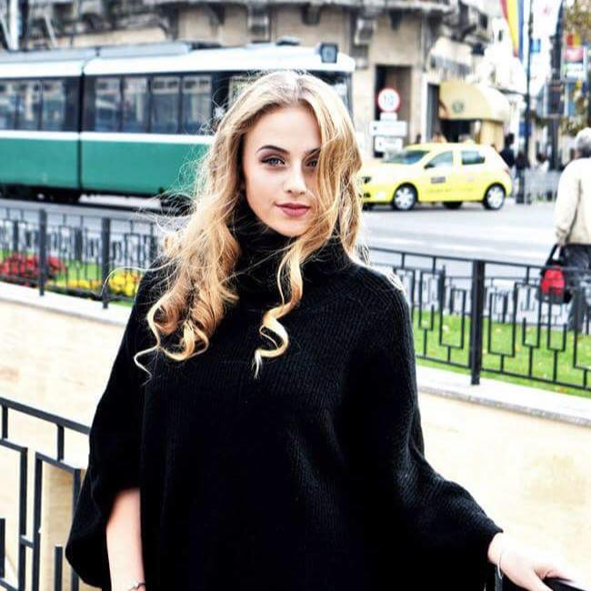
Team presentation
Mertic Lucia-Maria
Mateeșescu Niki
Bursuc Ștefana
Lungu Ștefania
Blanaru Ioana

Slide 4
Agenda
Project presentation
Figma model
Database layer
Backend code/Swagger
Frontend code
Developer/Automated Testing
Project Demo
Q&A

Slide 5
Project presentation
Features applicable for our project :
Web service with onion architecture;
Landing screen with options to add login name and password/Forgot password;
Each form has one of more of the following options: Add, Edit, Delete.
Approval/Rejection features by the administrator role;
A short user manual implemented as a web page in application.

Slide 6
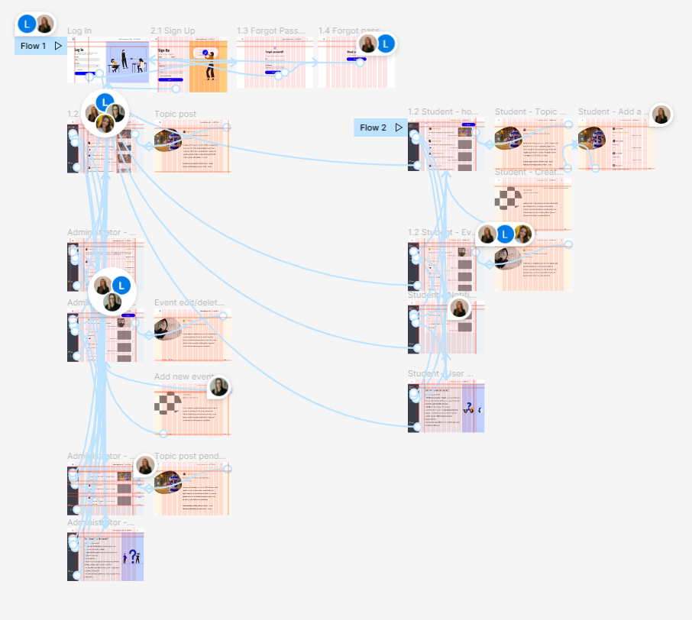
UI/UX design with Figma
We designed our project in Figma.
We learned:
how to choose the right colors, typography, shapes and sizing;
how to create wireframes;
how to interact with the design, making interactive components;
how user psychology works so that any user can easily find the information they’re looking for.
Figma file:
https://www.figma.com/file/N1io0vcjacQL5mSzuIvTcR/Centric-Summer-Practice--Students-of-Tudor-Vladimirescu's-Portal?node-id=2%3A135

Slide 7
Database layer
For the project we have to design a database for an application that manages the activity of a campus.
User - students are registered in the system with the help of an unique id; the first name, last name, email, avatar, password and if he is an administrator or not are memorized.
Event - events can only be created by the admin, they are registered in the system with the help of a unique id; the title, the content, the time it was created and the picture are memorized.
Likes_Event - the likes given by several users are registered in the system with the help of a unique id; the event id, the user id and the number of likes are memorized.

Slide 8
Database layer
Topics - topics created by students are registered in the system with the help of an unique id; the user id, the title, the content, the time it was created, the picture and the status are memorized.
Likes_Topic - the likes given by several users are registered in the system with the help of an unique id; the topic id, the user id and the number of likes are memorized.
Comment - comments added by users are registered in the system with the help of a unique id; the topic id, the user id and all the comments on each post are memorized.

Slide 9
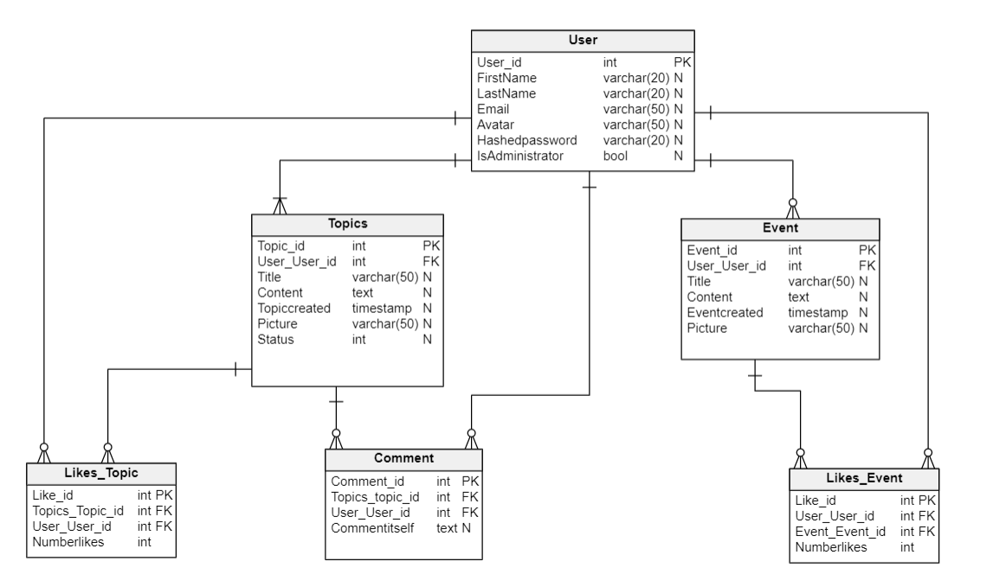
Database layer

Slide 10
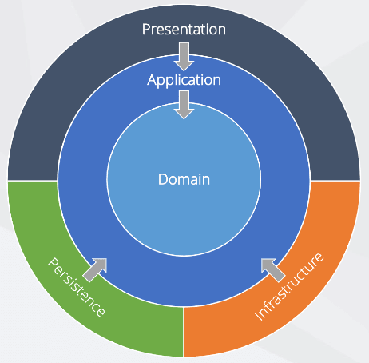
Backend
Our project uses onion architecture.

Slide 11
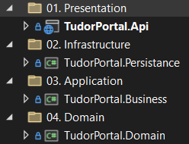
Backend
Domain is the CORE of the application. Here we have basic entities.
In Application we have business logic and business rules. We create our repository interfaces.
In Infrastructure we have things that can be used generically throughout the application. The implementation of the methods is decoupled.
The Presentation layer is the first and topmost layer present in the application where users can interact with the application.
GitHub : ttps://github.com/Luciebest/Backend

Slide 12
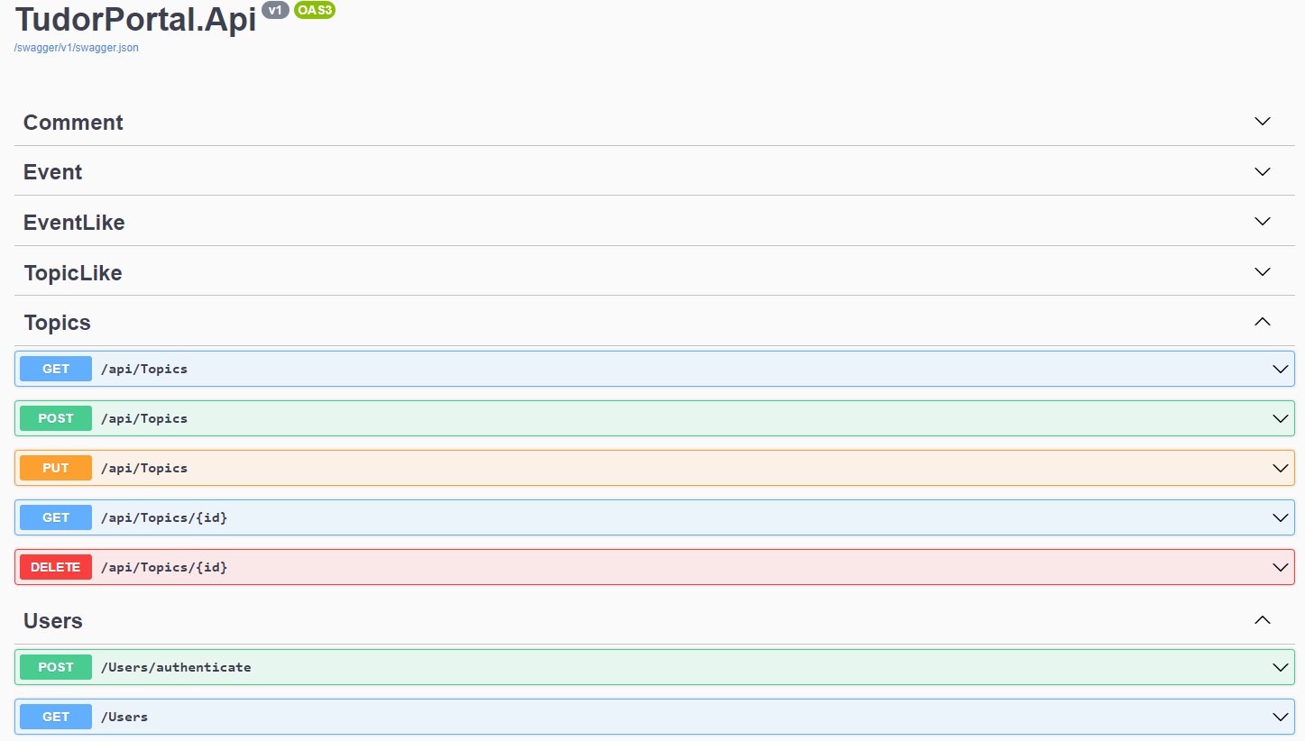
Backend
After we build our TudorPortal.Api presented in the previous slide, we can see in Swagger that our entities have been created. All of them (besides users) have the functionalities presented in the picture.

Slide 13
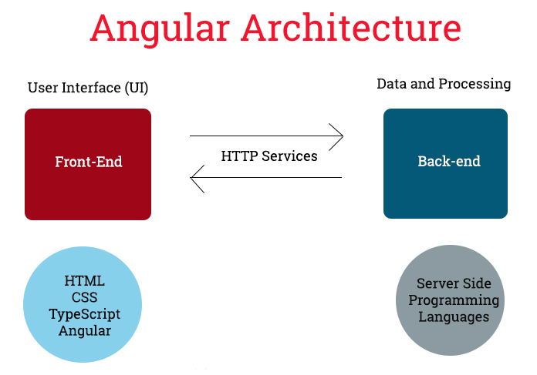
Frontend
We learned how to create a project using :
HTML
CSS
ANGULAR
TYPESCRIPT

Slide 14
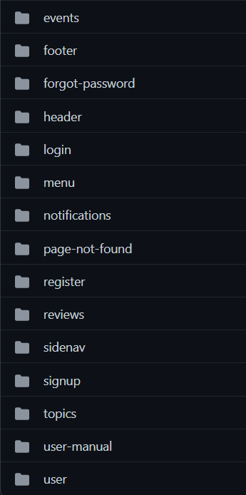
Frontend
The image shows the front-end components that we used for each functionality.
Github : https://github.com/Luciebest/Frontend

Slide 15
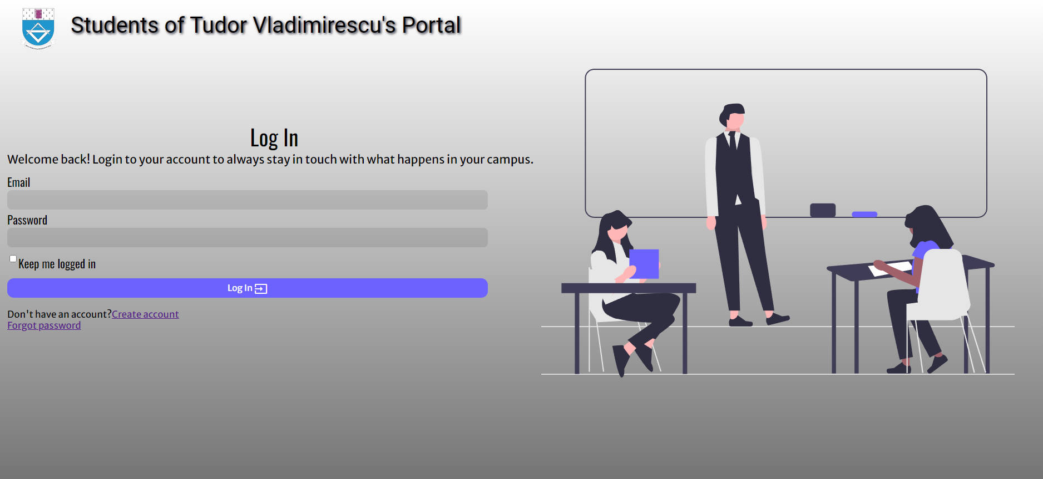
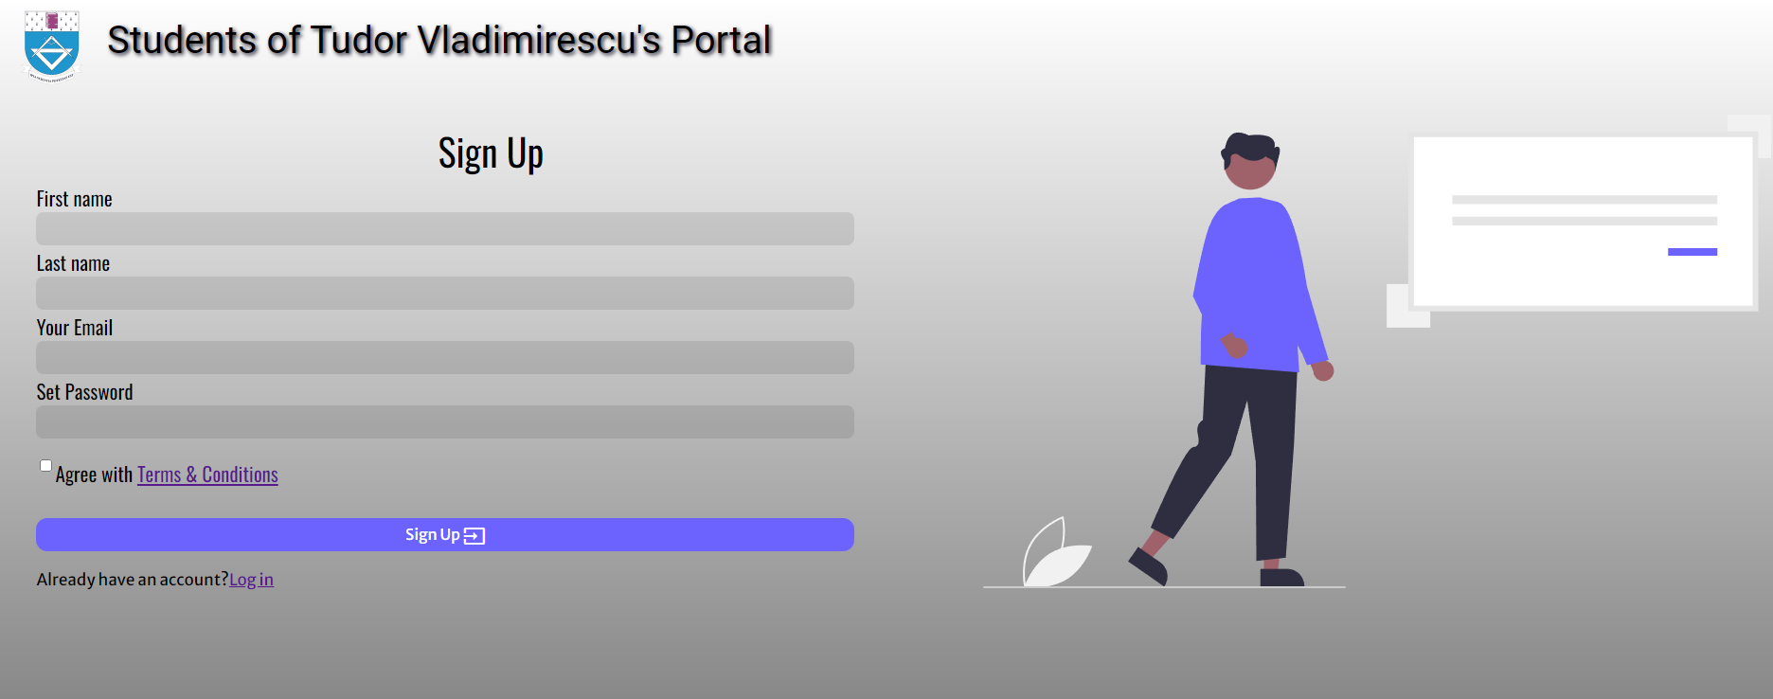
Frontend
These are our Login and Sign up pages.

Slide 16
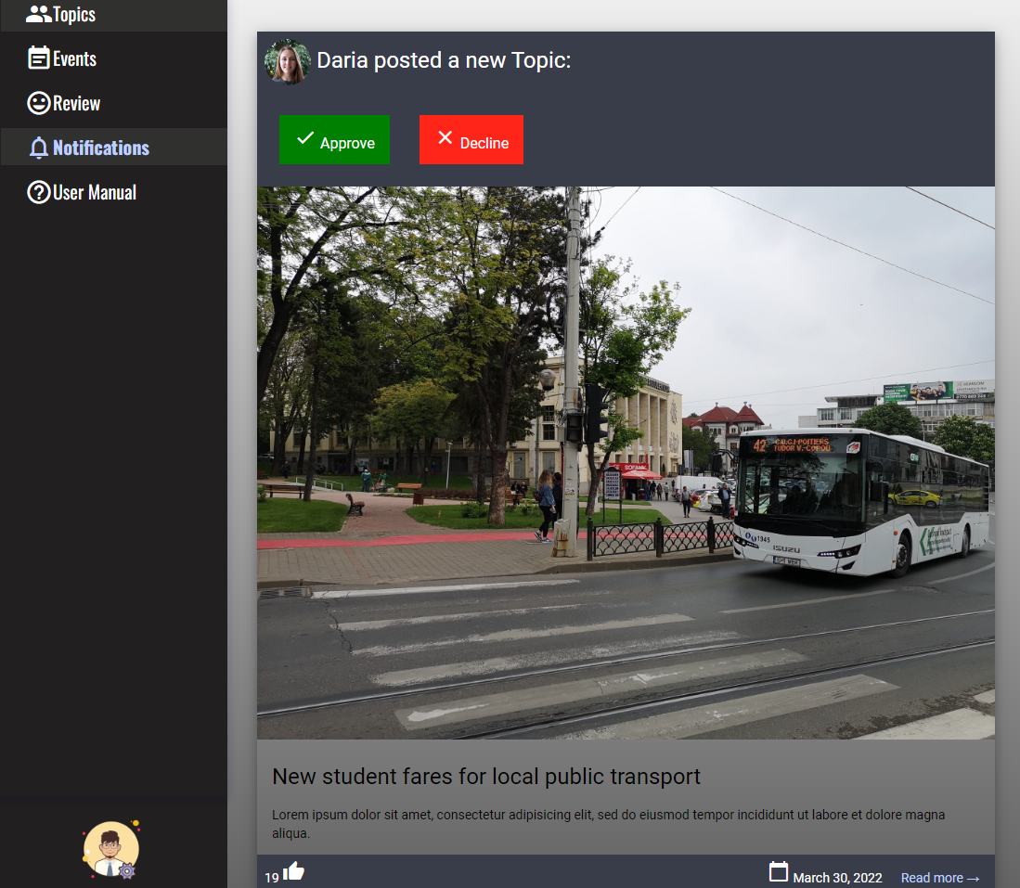
Frontend
This is an example of notification that the admin receives and evaluates it before accepting or rejecting.

Slide 17
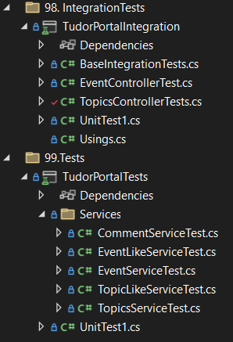
Developer Testing
Here we use unit testing on services and integration testing on controllers.

Slide 18
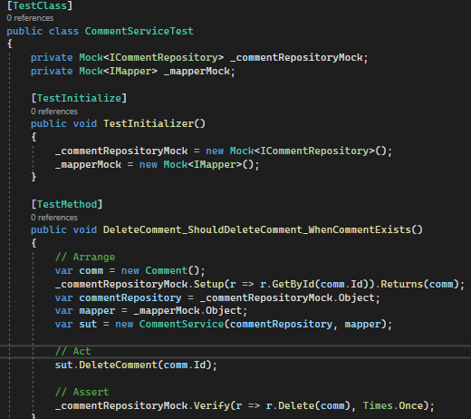
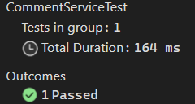
Developer Testing
This is an example for a service test that we did on our comment entity.

Slide 19
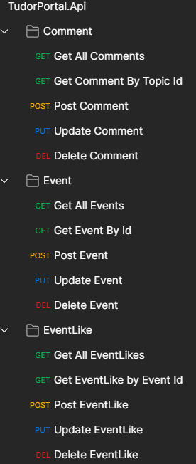
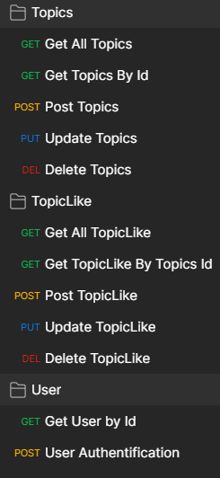
Automated Testing
For testing APIs, we made use of Postman. We easily created requests, which enhanced the end-to-end testing experience.
We did tests for all the CRUD methods we had in Swagger.

Slide 20
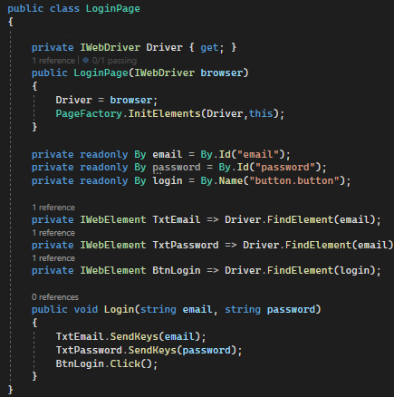
Automated Testing
This is an example of Web Services testing that we did on our login page.

Slide 21
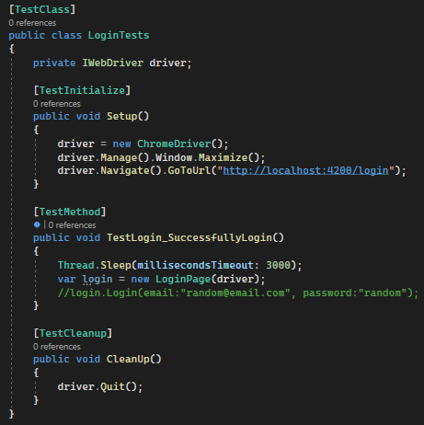
Automated Testing
Github:
https://github.com/Mateesescu-Niki/AutomatedTests/tree/master

Slide 22
Project Demo

Slide 23
Q&A

Slide 24


